Slide 1
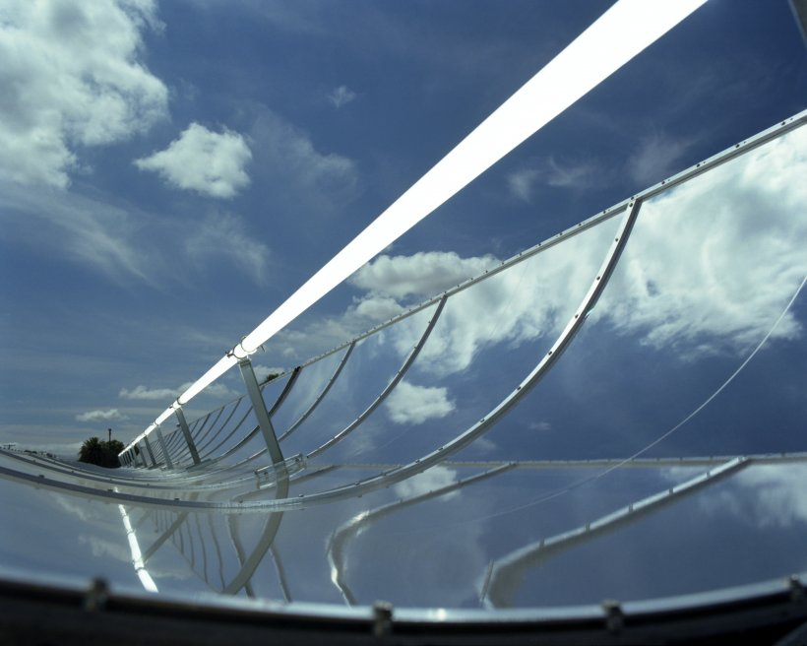
Helianthus Collector
Group 21301

Slide 2
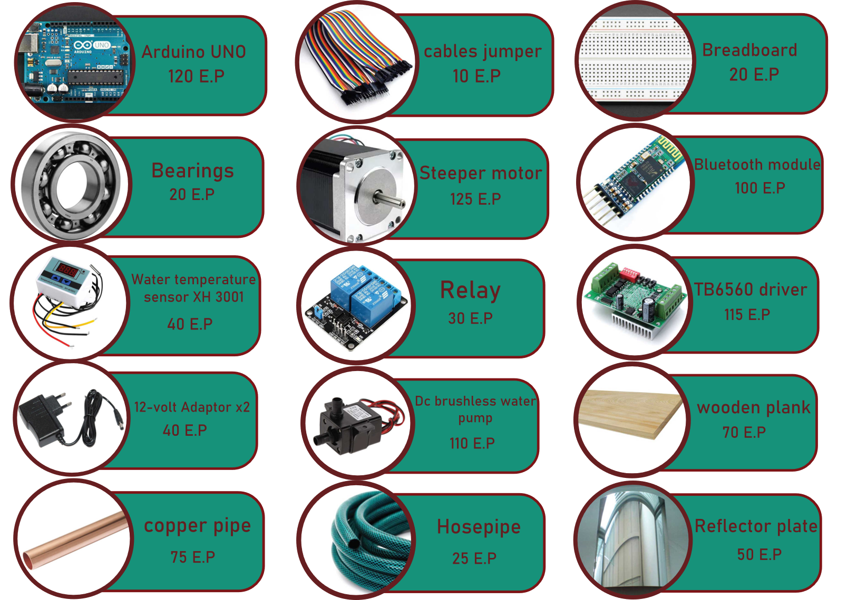
Materials

Slide 3
Test plan
There are main two test plans that have been done; in the first one, the prototype was fixed, did not contain a tracing system, on the surface in the north direction, the prototype takes a long time until it reached 10 degrees difference from. In the second test plan, the prototype was connected to the stepper motor, that make it able to move to trace the sun’s direction, the prototype was settled by an angle of 30.22 to the south which is Obour city’s latitude, this test was held at 12 AM with a temperature of 17°c, at which reached 10 degrees difference in temperature, which took less time compared to the first trial.

Slide 4
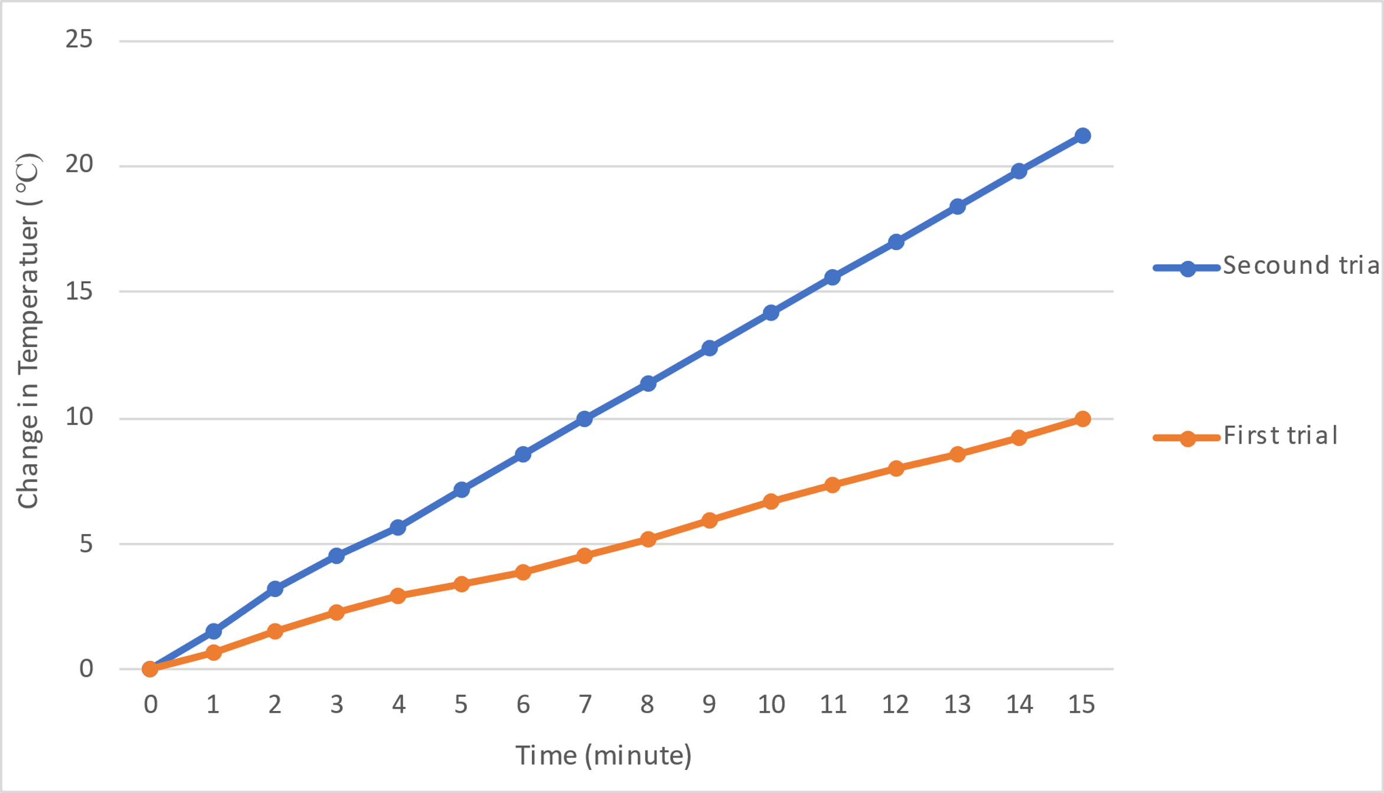
Results
There are main two test plans that have been done; in the first one, the prototype was fixed, did not contain a tracing system, on the surface in the north direction, the prototype takes a long time until it reached 10 degrees difference from. In the second test plan, the prototype was connected to the stepper motor, that make it able to move to trace the sun’s direction, the prototype was settled by an angle of 30.22 to the south which is Obour city’s latitude, this test was held at 12 AM with a temperature of 17°c, at which reached 10 degrees difference in temperature, which took less time compared to the first trial.

Slide 5
Graphs
Solar intensity during the day

Slide 6
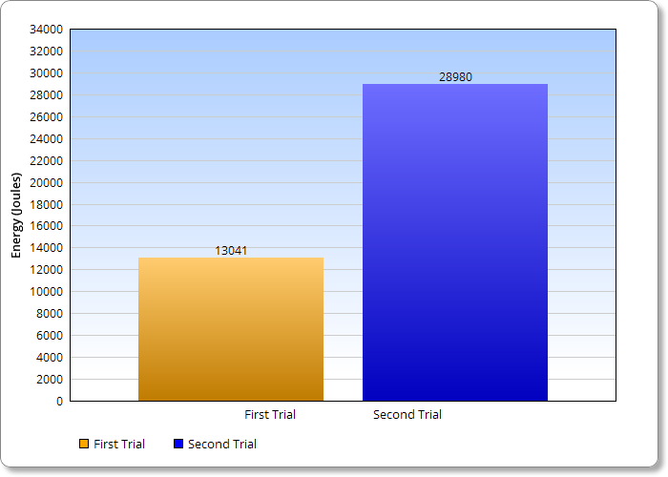
Trials’ Energy

Slide 7

Calculations
Efficiency :
$$\frac{T_{2}−T_{1}}{T_{1}}∗100$$
= $\frac{29.2−19.2}{19.2}∗100$
= 52%

Slide 8
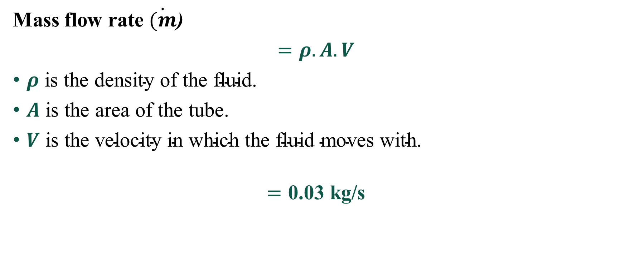
Calculations
Mass flow rate $\dot{(m}$)
$=ρ.A.V$
$ρ \text{is} \text{the} \text{density} \text{of} \text{the} \text{fluid}\text{.}$
$A \text{is} \text{the} \text{area} \text{of} \text{the} \text{tube}\text{.}$
$V \text{is} \text{the} \text{velocity} \text{in} \text{which} \text{the} \text{fluid} \text{moves} \text{with}\text{.}$
$$=\text{0.03 }\text{kg}\text{/}\text{s}$$

Slide 9
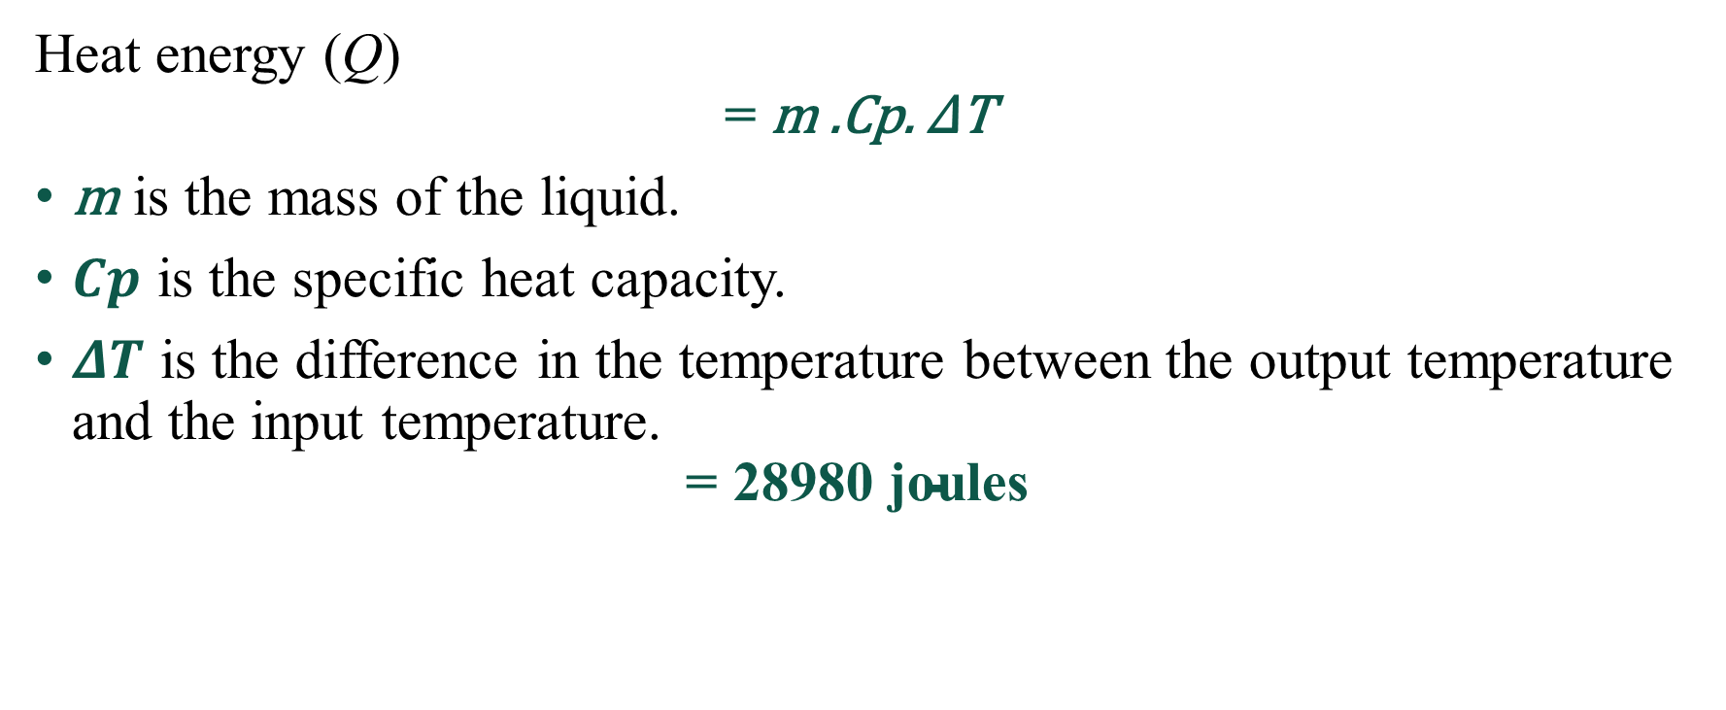
Calculations
Heat energy (Q)
$$\text{=} \text{m}\text{ .}\text{Cp}\text{. }\text{Δ}\text{T}$$
$\text{m}$ is the mass of the liquid.
$Cp$ is the specific heat capacity.
$ΔT$ is the difference in the temperature between the output temperature and the input temperature.
$$\text{=} \text{28980 }\text{joules}$$

Slide 10
Calculations
Heat energy (Q)
$$\text{=} \text{m}\text{ .}\text{Cp}\text{. }\text{Δ}\text{T}$$
$\text{m}$ is the mass of the liquid.
$Cp$ is the specific heat capacity.
$ΔT$ is the difference in the temperature between the output temperature and the input temperature.
$$\text{=} \text{28980 }\text{joules}$$

Slide 11
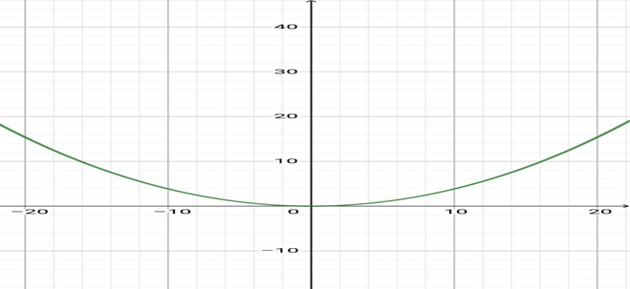
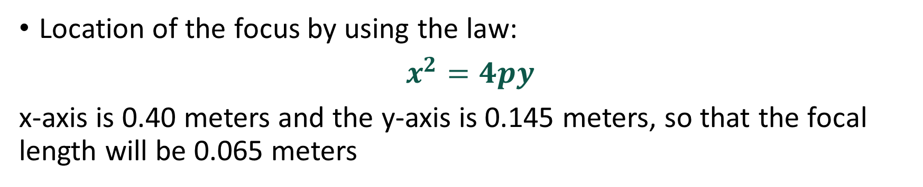
Calculations
Location of the focus by using the law:
$x^{2}=4py$
x-axis is 0.40 meters and the y-axis is 0.145 meters, so that the focal length will be 0.065 meters

Slide 12
Literature Cited
Concentration with a parabolic reflector. 2.4 Concentration with a Parabolic Reflector | EME 812: Utility Solar Power and Concentration. (n.d.). Retrieved November 29, 2021. https://www.e-education.psu.edu/eme812/node/557 • Gama, A., Larbes, C., Malek, A., Yettou, F., & Adouane, B. (2013). Design and realization of a novel sun tracking system with absorber displacement for parabolic trough collectors. Journal of Renewable and sustainable energy, 5(3), 033108. https://doi.org/10.1063/1.4807476 • GREENPOWERSCIENCE, (2010, October 22). DIY Parabolic Trough Mirror made in 20 minutes Stainless Steel Mirror free energy from the sun. [Video File]. https://www.youtube.com/watch?v=St-0HWKAY4k • Halliday, D., Resnick, R., & Walker, J. (2013). Fundamentals of physics. John Wiley & Sons. • Hamidi, S. T., Fattah, F. A., & Ghanam, M. S. (2018). Performance Improvement of the Parabolic Trough Solar Collector Using Different Types of Fluids with Numerical Simulation. Journal of University of Babylon for Engineering Sciences, 26(6), 332-347. https://doi.org/10.29196/jubes.v26i6.1437

Slide 13
Conclusion
After we got our results, we concluded that we were able to increase the temperature of the water by collecting the heat energy from the sun by 10°c in only seven minutes with efficiency 52%. Also, we were able to reach the continuity for our project as we were able to build a tracing system on moving with the sun without the need for any light sensor, which was used in the previous solar panel projects. The light sensor can be less efficient because it can be distracted by any other light source. However, in our tracing system, it was different because it depends on adding data to an Arduino system that is needed to move the stepper motor with the angle that is needed to keep tracking the sun. Also, we used a pump. We connected it with the Arduino to move the water in the system when needed. Finally, the heat energy collected in a fluid could be used in many different ways as generating electricity or in any industry that needs heat in its processes as a source of heat.

Slide 14
Recommendation
Despite all the limitations we faced, our prototype succeeded in reaching our goal of improving the design of the parabolic trough to make it more efficient and make it more continuous by using modern technology like communication technology. We encountered some limitations that, unfortunately, we could not overcome problems, so we recommend that future researchers:
• Researching on using molten salt in the large-scale parabolic trough’s power cells to work instead of water because it needs at least 500 degrees Celsius to be melted and can store the heat energy inside of it for up to 7 hours
• On a large scale, future researchers could connect to a climate center to provide the parabolic trough with the needed data and angles to make the tracing system work more accurate.
• Provide the project with thermal insulation materials to maintain the water or fluid temperature in the system and prevent any energy loss that can occur in the system. materials as mineral wool, cellulose and fiberglass are practical examples of thermal insulation materials that we can use in the system
• The best replacement for the water as fluid is molten salt, nanofluids, or oil, as they have more heat capacity than the water and do not lose heat faster.
• providing thermal insulation containers to transport the heated fluid to any organization that will need this fluid is essential the large-scale
• As a large-scale project, safety is a property that should be considered; thus, researchers can use more than one water temperature sensor to read the difference between them and detect the fluid's temperature with higher accuracy. This procedure will increase the project's safety by closing the system and the water flow if the fluid temperature becomes too high to handle by the pipes. So, they can explode and cause damages to the system

Slide 15
Thanks for your time.

